Slide 1

CRYPTOCURRENCIES
Alex Wolf, Jack Lindsay, Katie Manthey, Supraja Sharma & Kim Konopka

Slide 2


Slide 3

₿ACKGROUND
What is cryptocurrency?
What is Bitcoin?
Why should we care about Bitcoin and cryptocurrency?
What is the future for cryptocurrency?
What would be the significance of Bitcoin driving market behavior for other cryptocurrencies?
Notes:
What is cryptocurrency?
-Cryptocurrency is defined as electronic money made with technology to:
-control how it was made
-protect transactions
-hide the identities of the users
-People have their computers work many hours and expend massive amounts of electricity and solve mathematical equations to “mine” the digital money.
What is Bitcoin?
-Bitcoin was the first widely adopted cryptocurrency, and was created in 2009 by an anonymous developer, Satoshi Nakamoto. **Fun fact** Satoshi Nakamoto disappeared before Bitcoin really took off.
-Bitcoin is decentralized from government control allowing for user-to-user sending transactions
-Bitcoin’s advantages are efficiency, permanency, security and transparency.
Why should we care?
-Bitcoin can be used to make big and small purchases, it is used widely as an investment vehicle and it provides an opportunity to escape from the financial collapse of some countries.
What is the future for cryptocurrency? While the future of this currency is “cryptic”, one thing seems to hold true, and that is the fact that is isn’t going anywhere. The technology has been branching out into the IT security field and the use cases for the currency grow day by day.
What would be the significance of Bitcoin driving market behavior for other cryptocurrencies? If Bitcoin’s predictability holds true, one could simply monitor the finance giant and buy/sell the alt coins based on the movement of Bitcoin

Slide 4

HYPOTHESIS*
Bitcoin influences the market movement of alt coins
NULL-HYPOTHESIS
Bitcoin has no correlation or influence on alt coins
Notes:
Bitcoin is perceived as the pathfinder of cryptocurrencies, where it goes the others follow. Therefore, we believe that we are going to be able to reject the null-hypothesis, proving that Bitcoin does influence other cryptocurrencies.

Slide 5










Variables
Independent Variable: Bitcoin
Dependent Variables : the top 9 other cryptocurrencies, selected by their market cap
Notes:
For this we choose Bitcoin and these nine other currencies because of their market volume: Binance Coin, Bitcoin Cash, EOS, Ethereum, Chainlink, Litecoin, Tron, Stellar, Ripple.

Slide 6
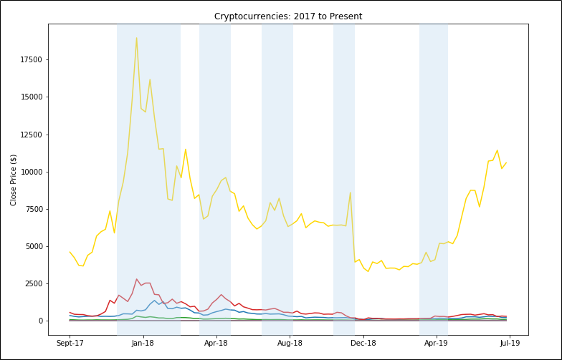
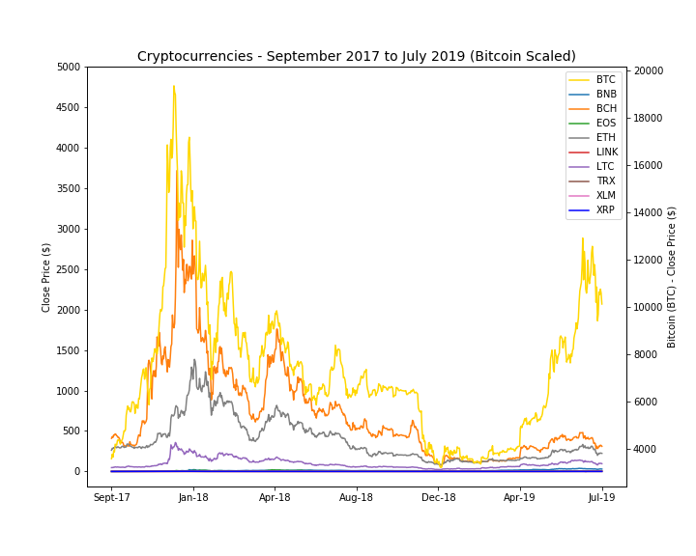
Why are we interested in Cryptocurrency?
Notes:
The graph shows the selected aforementioned cryptocurrencies by price, highlighted in blue are some of the most apparent correlating points in the data, however at this scale it’s hard to detect all of them. This peaked our interests as to why these correlations exist, and as they seem to follow Bitcoin (the very large gold line) very closely, if Bitcoin is indeed a leading indicator of cryptocurrency trends.

Slide 7



Data Sources
Cryptocurrencies:
Notes:
We attempted to start with multiple Kaggle datasets and merge by dates. Problems: dates and data and formatting inconsistencies.
Then opted for API but faced similar issues. Ended up using both API and Yahoo Finance Data for weekly data points, and just Yahoo Finance for daily data points, due to API limitations.

Slide 8
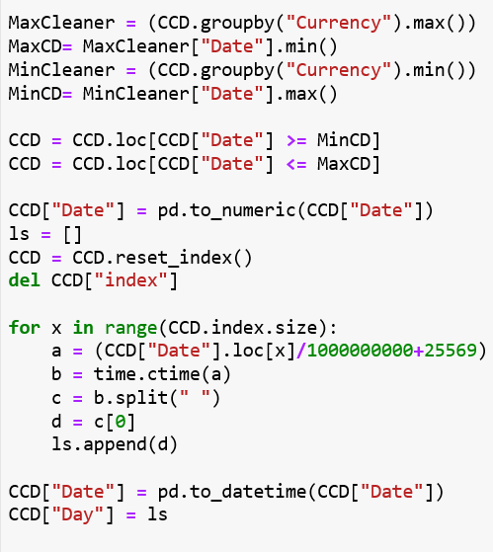
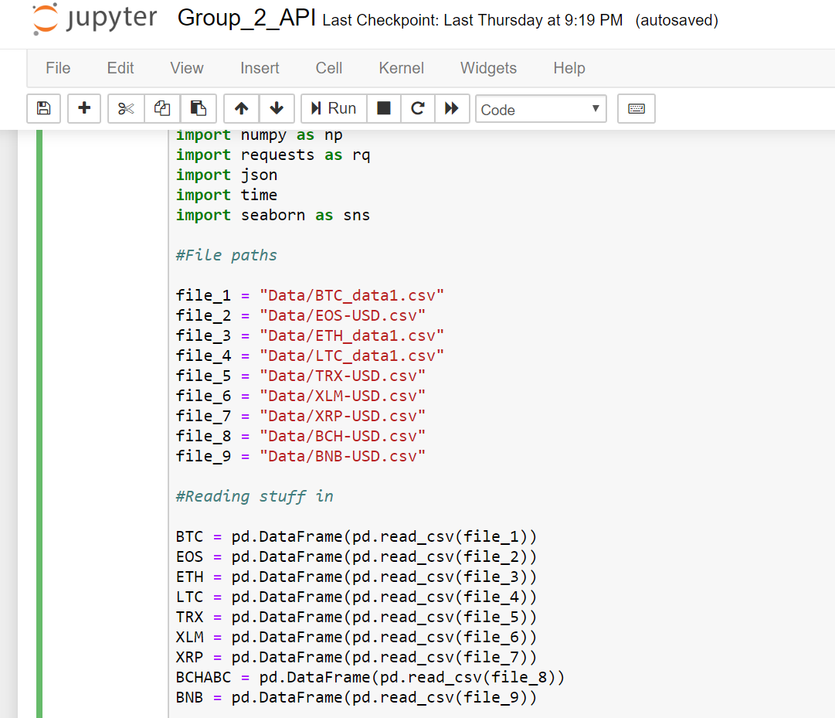
Notes:
As mentioned prior we tried to use Kaggle, here is showing just code set of what it took to reformat and splice just one dataset by Dates. Rather than having to do this type of data cleaning for multiple files, each with their own issue, we opted for cleaner data was more readily available.
Then after using the API, it too faced similar issues, however we able to get clean data for three of the CC’s; Bitcoin, Litecoin, and Ethereum and only weekly data points from those. Then supplemented that data with clean, and consistent dataset from Yahoo Finance.
After the data exploration and gathering process Each Cryptocurrency ended up having just shy of 13000 data points ranging from 2014 to present. A similar process was used in the controls.
Now that we the required amount of data, we then moved in the data cleaning and analytical processes, where my teammate, Katie, will the explain how we conducted those.

Slide 9
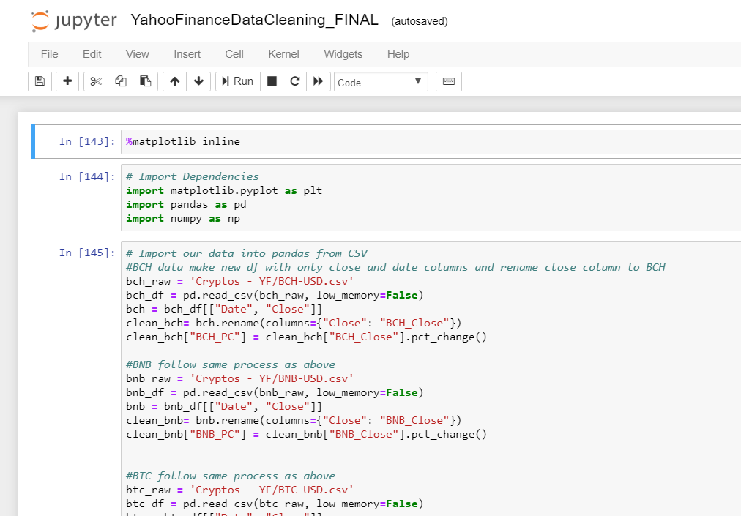

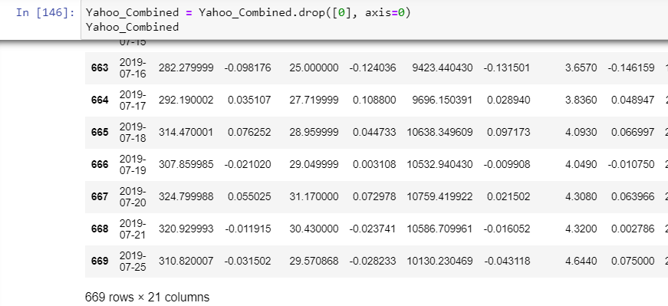
Notes:
Here we read in all of the data files, created a df with only the columns of interest, date and a close price and calculated the percent change on the close price b/c needed to have everything on an even scale. From there we did an inner merge of all the data files on the date value. This means we only kept the dates for which all coins had a close value. We had to drop the first row, bc as we know with a percent change for the first date there is no change. This resulted in us having 669 rows of data, across 10 coins, thus we have enough data to proceed. Data is for 10 coins across 3 years 2017-2019

Slide 10
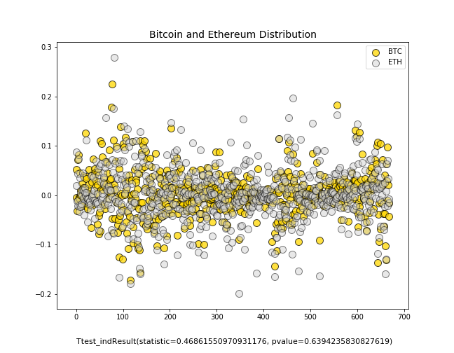
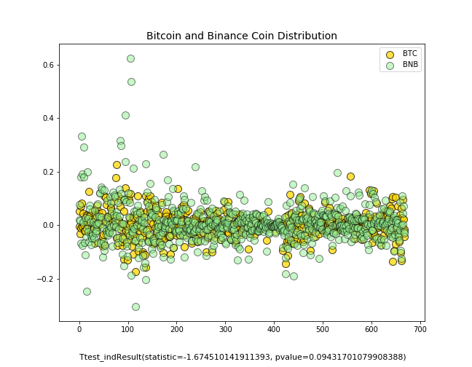
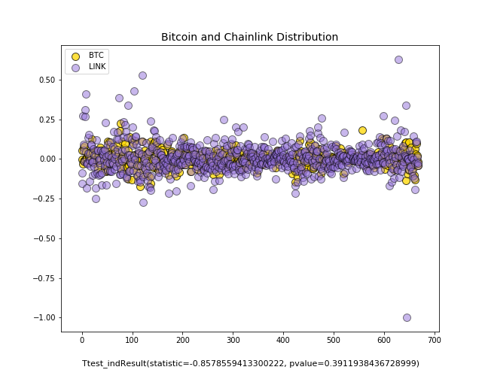
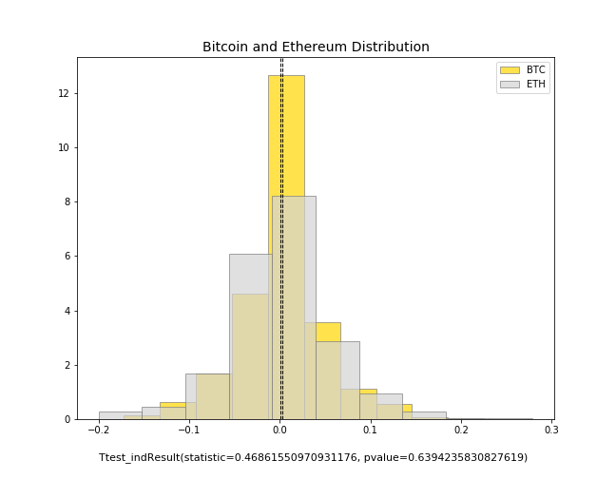
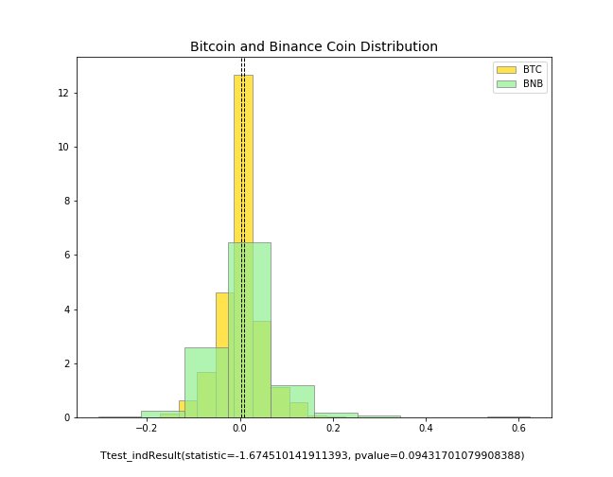
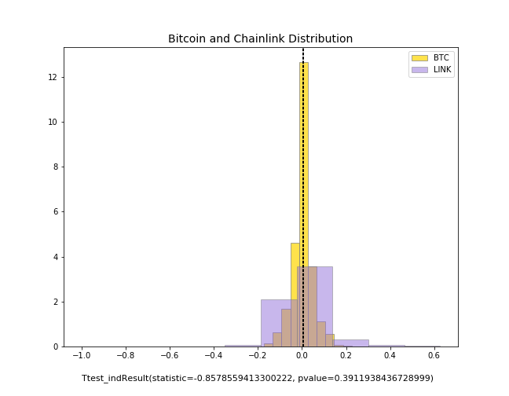
Do the percent changes in close price of Bitcoin differ from other alt. coins?
Notes:
from there we group data, and assign colors to each group for plotting, we chart a histogram a scatter plot of each pair of data, Bitcoin compared to the other coin of interest and include the t-test of the two samples of data
Does the percent change in close price of BTC differ from the percent change in close price of other alt. coins?
we learned that in general the data sets follow a normal distribution and there is no distinguishable difference between the distribution if the data sets as all p-values were greater than .05
The answer is NO, but what we really want to know is does Bitcoin influence the changes in other coins?

Slide 11
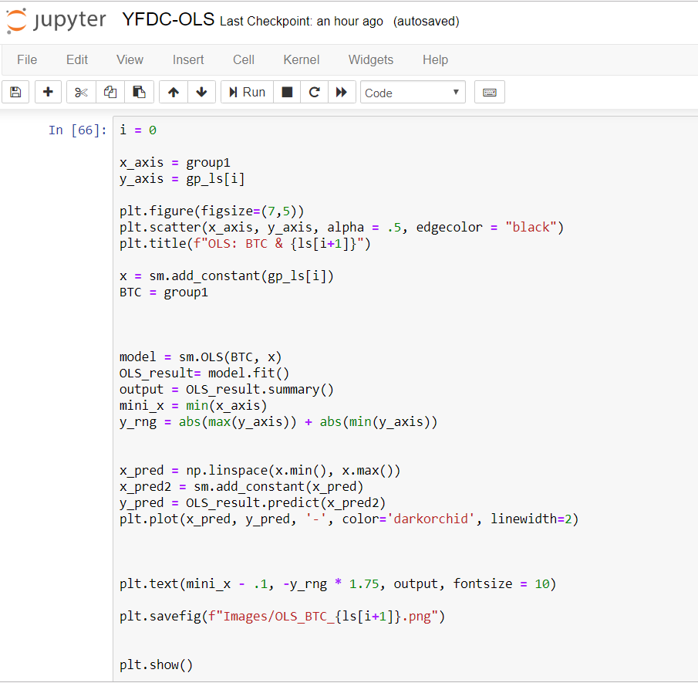

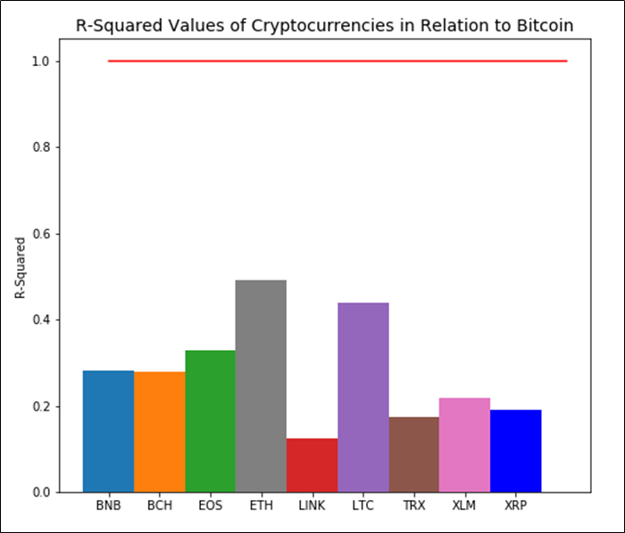
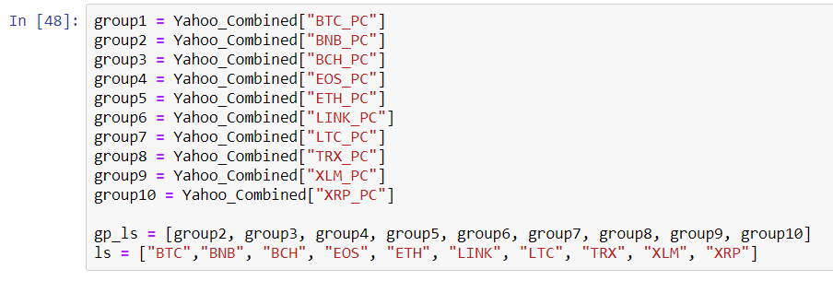
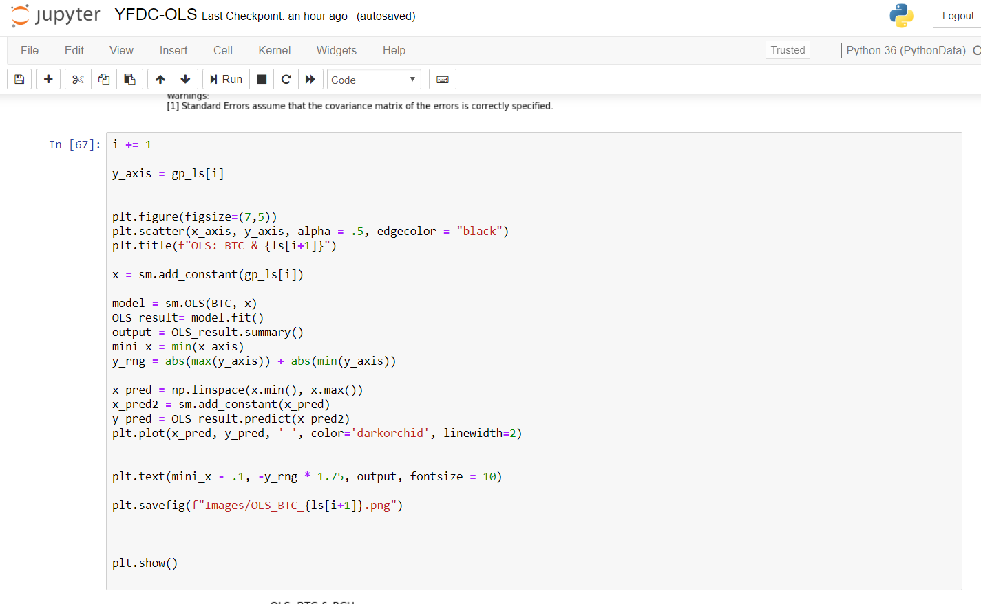

Slide 12
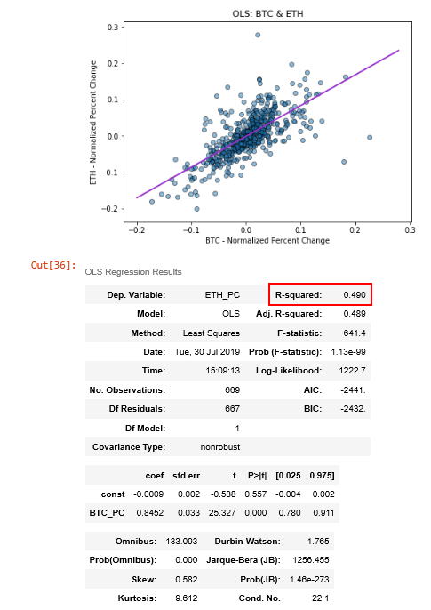
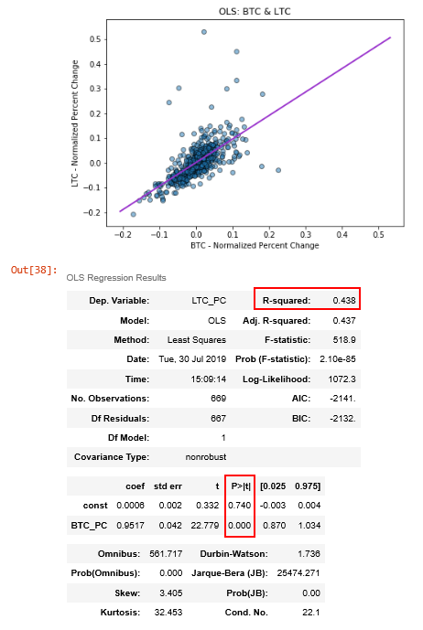

Notes:
almost half of the variation in ETH (49%) and LTC (44%) is explained by BTC
for every increase in BTC, ETC increases by about .85 and LTC by .95
however, neither are significant at the .05 level, thus we fail to reject the null, we do not have enough evidence to say that BTC influences the other

Slide 13

CONCLUSIONS
Fail to reject null-hypothesis
...we don’t have enough evidence to say that Bitcoin influences altcoin market trends

Slide 14
Future Approaches to Predictive Models for Cryptocurrencies
Machine Learning with the use of neural networks
specifically with Long Short-Term Memory (LSTM) Recurrent Neural Networks (RNN)
Use historical price data for cryptocurrencies from an API
Run many iterations in order to train the model until its outputs converge with a test set of data
Check with confidence interval and p-value
The more existing data points → better predictive model
Similar models could also be applicable in predicting stock market data
Possible Issues:
existing models of this nature typically predict new values close to the previous day values
Finance - historical prices/trends are not necessarily indicative of the future!

Slide 15
Limitations
Due to data availability we only focused on 3 most recent years of data
some data only more recently became public
Volatility of cryptocurrency market
Top ten cryptocurrencies by market value have changed over the past week
Need to include other possible variables that may affect any possible relationship between Bitcoin and altcoins
e.g. controlling for market movements of NASDAQ and DOW

Slide 16

Thank you!!! Questions?

Slide 17

.pct_change()

Slide 18


Slide 19


